Slide 1
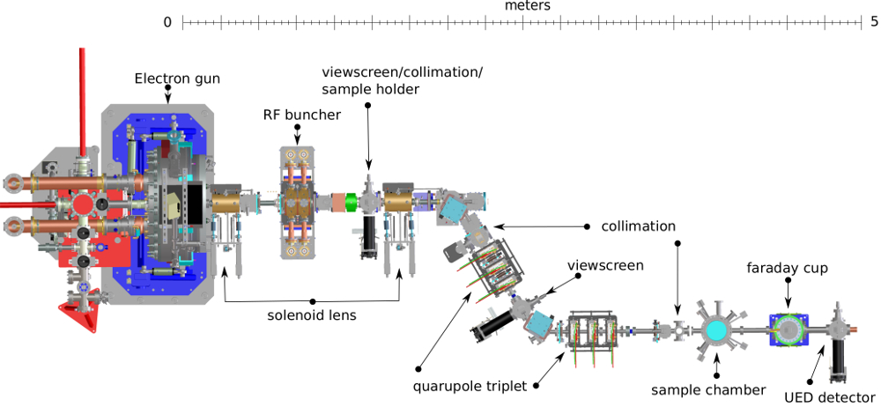
2nd Round of ML applied to HiRES:
Energy Stability
ANTONIO GILARDI
09/12/2021

Slide 2

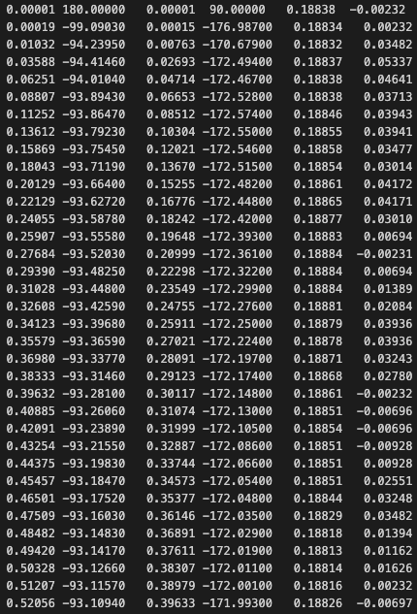
Laser question
Data Structure:
- FileName
- FileName.rf.dat
Loss-Less
In-loop Magnitude
In-loop Phase,
OOL Magnitude,
OOL Phase,
Laser Amplitude,
Laser Phase
- FileName.ucam1
- FileName.rf
- FileName.ucam1.dat
- FileName.rf.dat
- FileName.ucam1.dat.post
- FileName.rf.dat.post
- FileName.rf.dat.post
Original code:
>> x_cav_main = x[:,0]
>> x_cavp_main = x[:,1]
>> x_cav_aux = x[:,2]
>> x_cavp_aux = x[:,3]
>> x_egain_main = x_cav_main*np.cos(x_cavp_main*np.pi/180.0)
>> x_egain_aux = x_cav_aux*np.cos((x_cavp_aux+79.0)*np.pi/180.0)
Added code:
win = int(100e-6/ dt) <<
win_start = int(580e-6 / dt) <<
wsp = 4 <<
dt = wsp*22/(102.14e6) <<
x_laser_phs = x[:,5] <<
x_laser_phs_avg = np.mean(x_laser_phs[:,win_start:win_start+win], axis=1) <<
x_laser_phs_ac = (x_laser_phs_avg-np.mean(x_laser_phs_avg))/np.mean(x_laser_phs_avg) <<

Slide 3
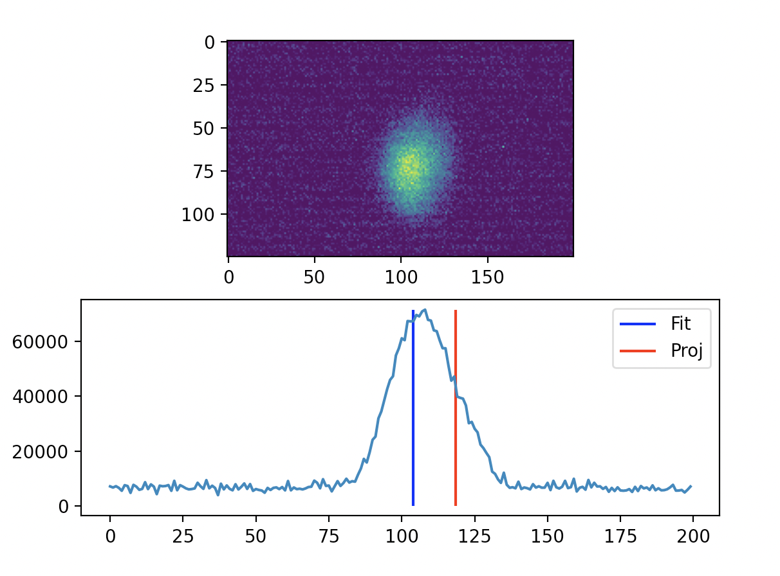
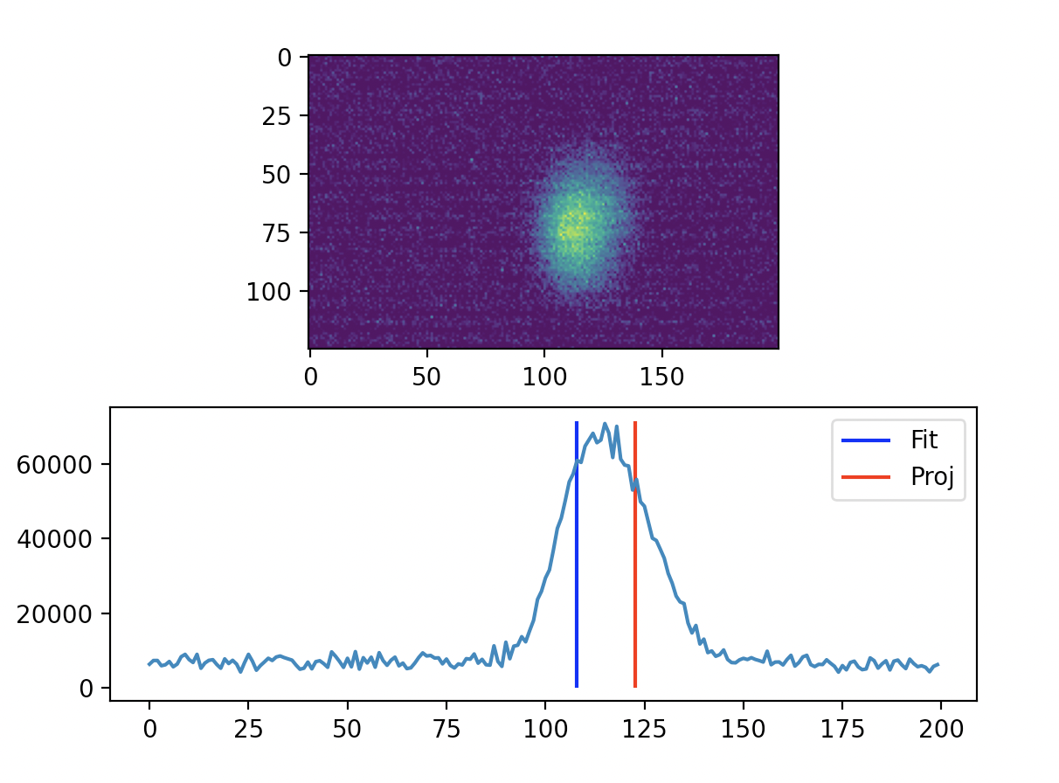
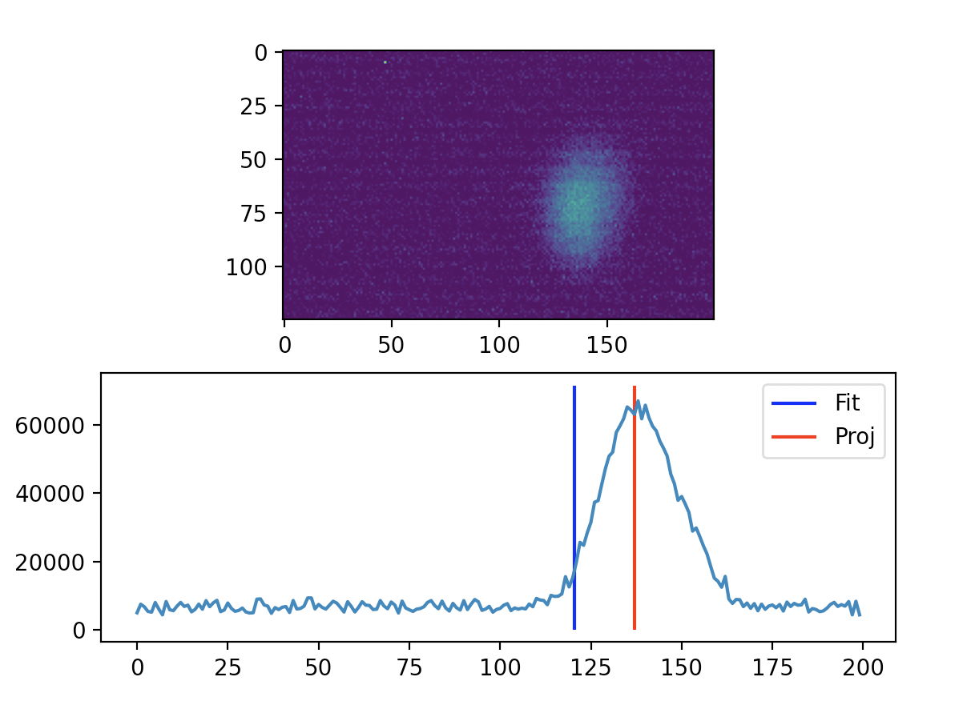
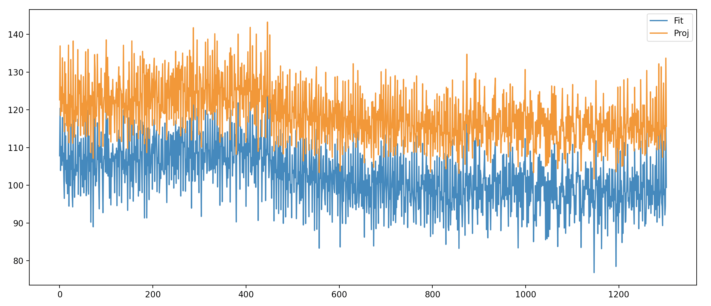
Camera Processing
X → Projected image
x is the beam image along the x axis
>> pX = x / np.sum(x)
>> CentroidProjection[i] = np.sum( x * pX)
In the following the fit information was used.

Slide 4
Dataset used
- Close loop capture:
- 20m0s capture: OK (sync_acq_wsp4_5ch_1hz_ucam1_lcam1_cloop_long)
- Buncher off
- 7818 / 6 = 1303 RF buffers
- 1303 ucam buffers
- Open loop capture:
- 20m0s capture: OK (sync_acq_wsp4_5ch_1hz_ucam1_lcam1_long)
- Buncher off
- 7818 / 3x2 = 1303 RF buffers
- 1303 ucam buffers
>> camFit = np.load("data/"+InOrOut+"/CameraFit.npy")
>> camProj = np.load("data/"+InOrOut+"/CameraProj.npy")
>> OL_phs = np.load("data/"+InOrOut+"/OL_Phase.npy")
>> OL_amp = np.load("data/"+InOrOut+"/OL_Magnitude.npy")
>> ILmOL_phs = np.load("data/"+InOrOut+"/OL_Phase.npy") - np.load("data/"+InOrOut+"/IL_Phase.npy")
>> ILmOL_amp = np.load("data/"+InOrOut+"/OL_Magnitude.npy") - np.load("data/"+InOrOut+"/IL_Magnitude.npy")
>> laser_Phs = np.load("data/"+InOrOut+"/Laser_Phs.npy")
>>laser_amp = np.load("data/"+InOrOut+"/Laser_Amp.npy")

Slide 5
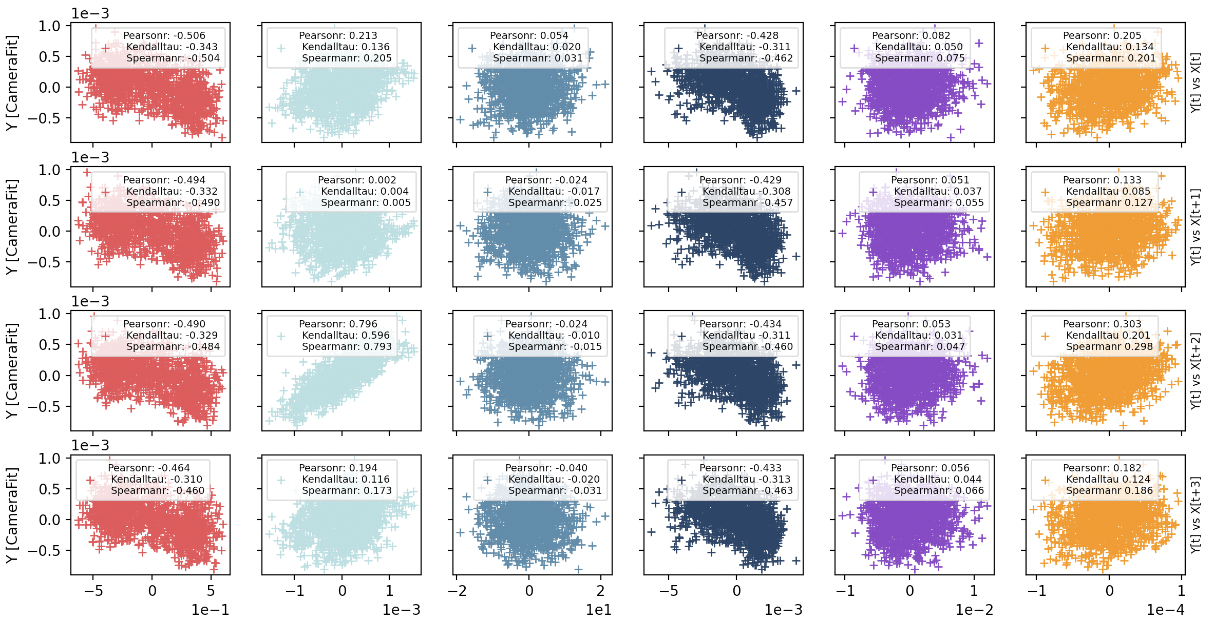
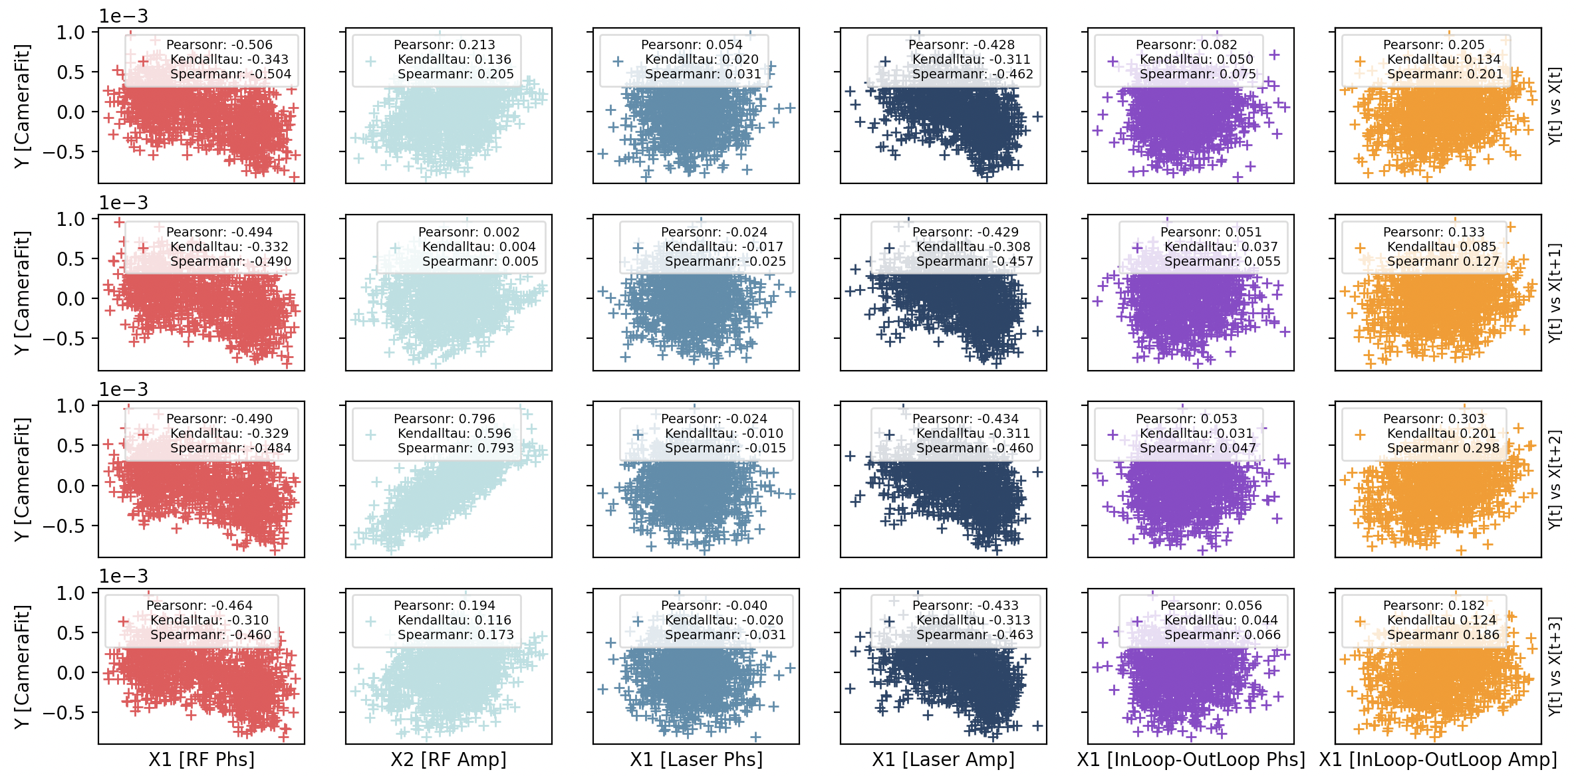
Feature selection
OUT OF LOOP -----------> No feedback stabilization

Slide 6
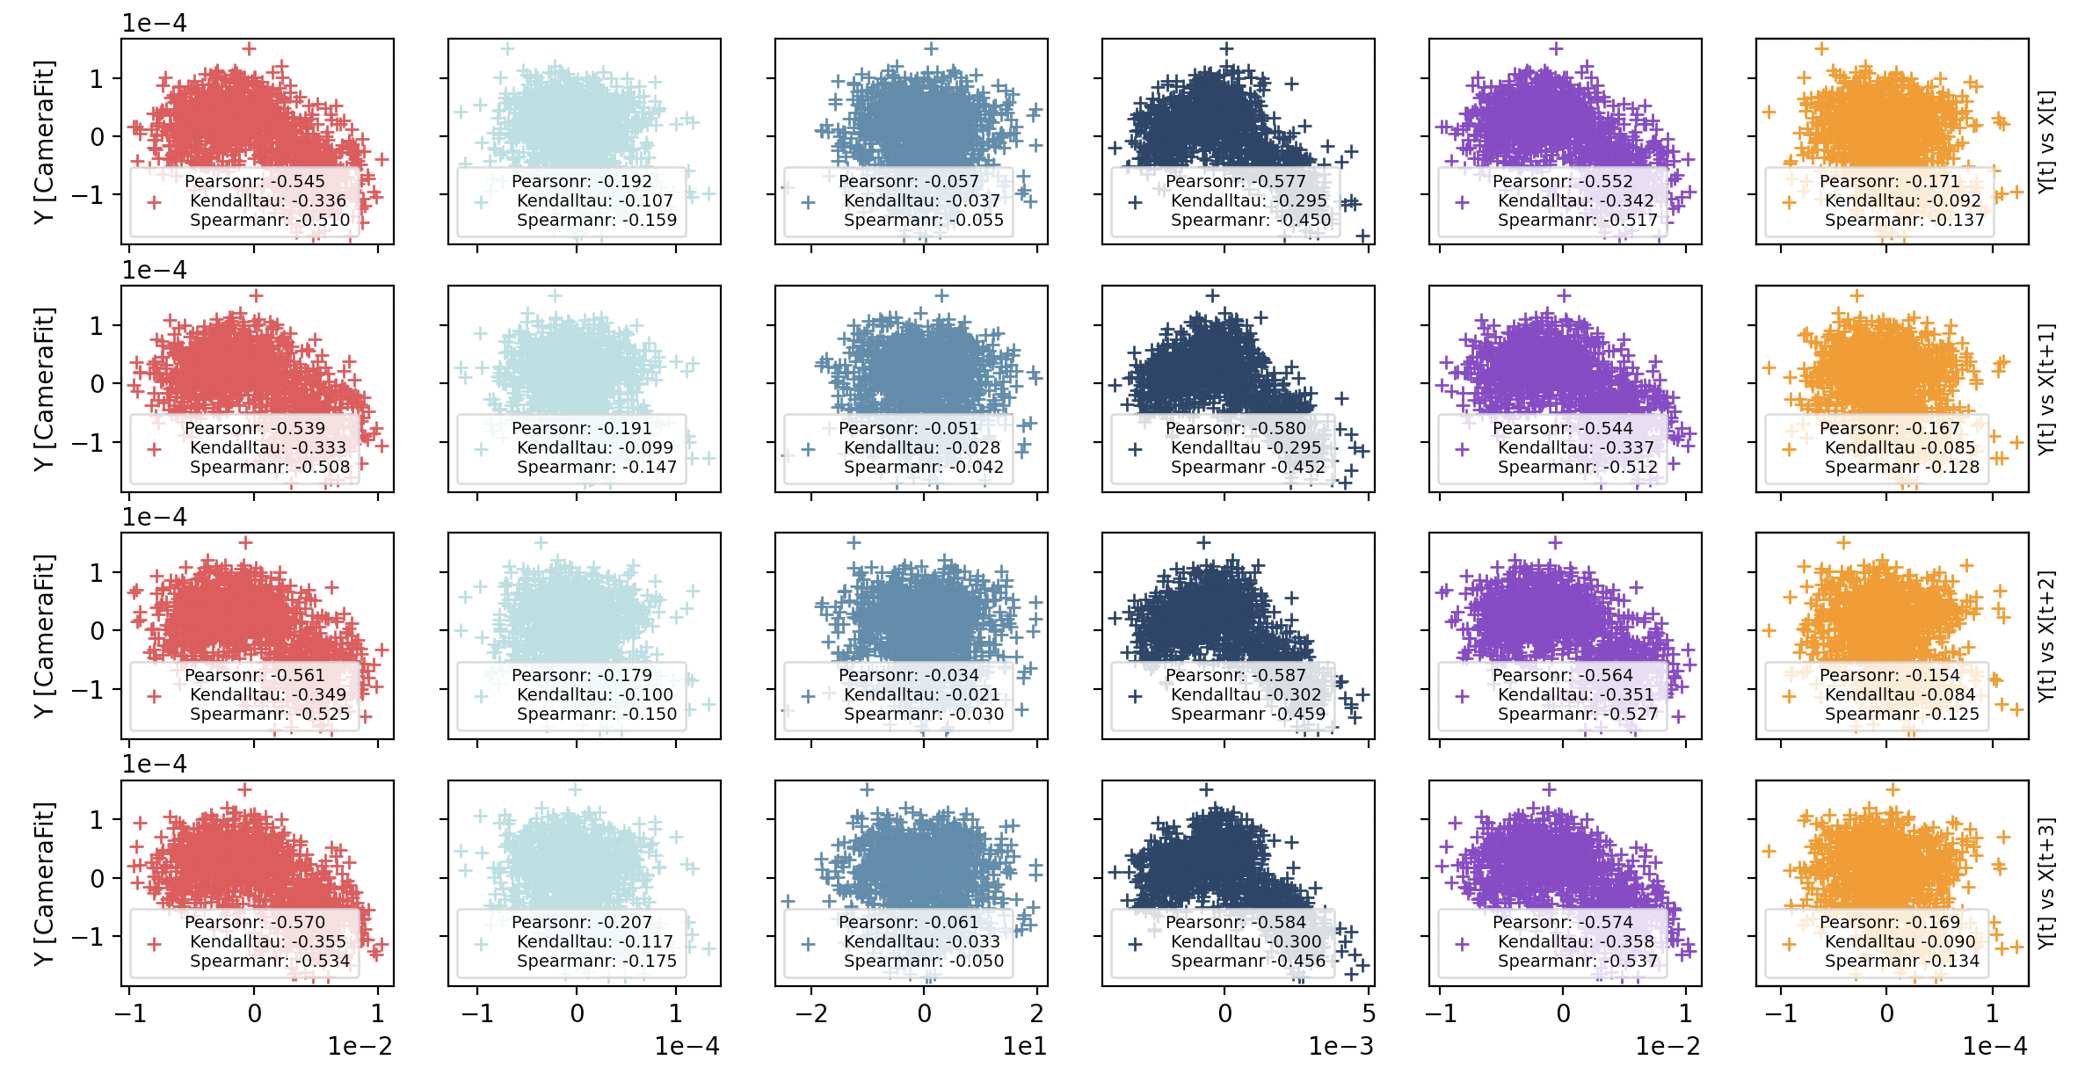
Feature selection
IN LOOP -----------> Feedback stabilization

Slide 7
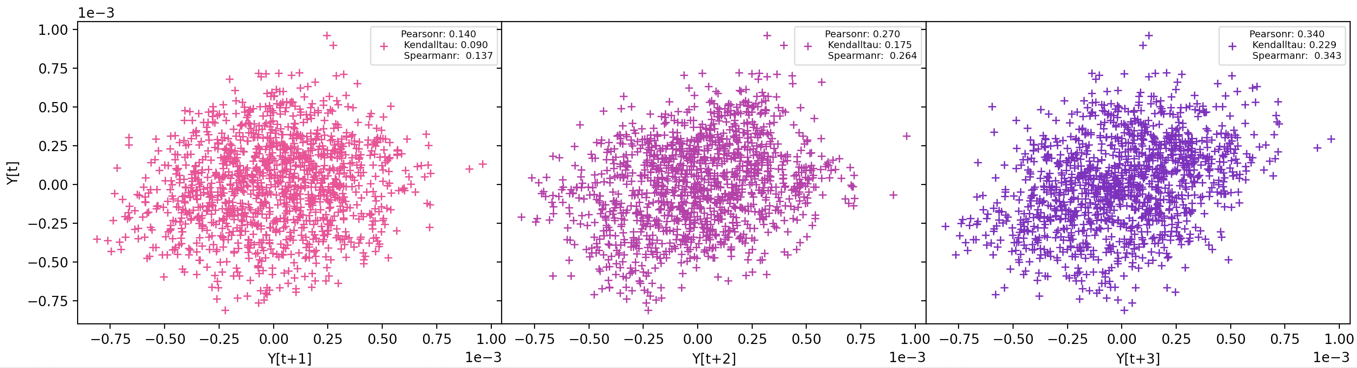
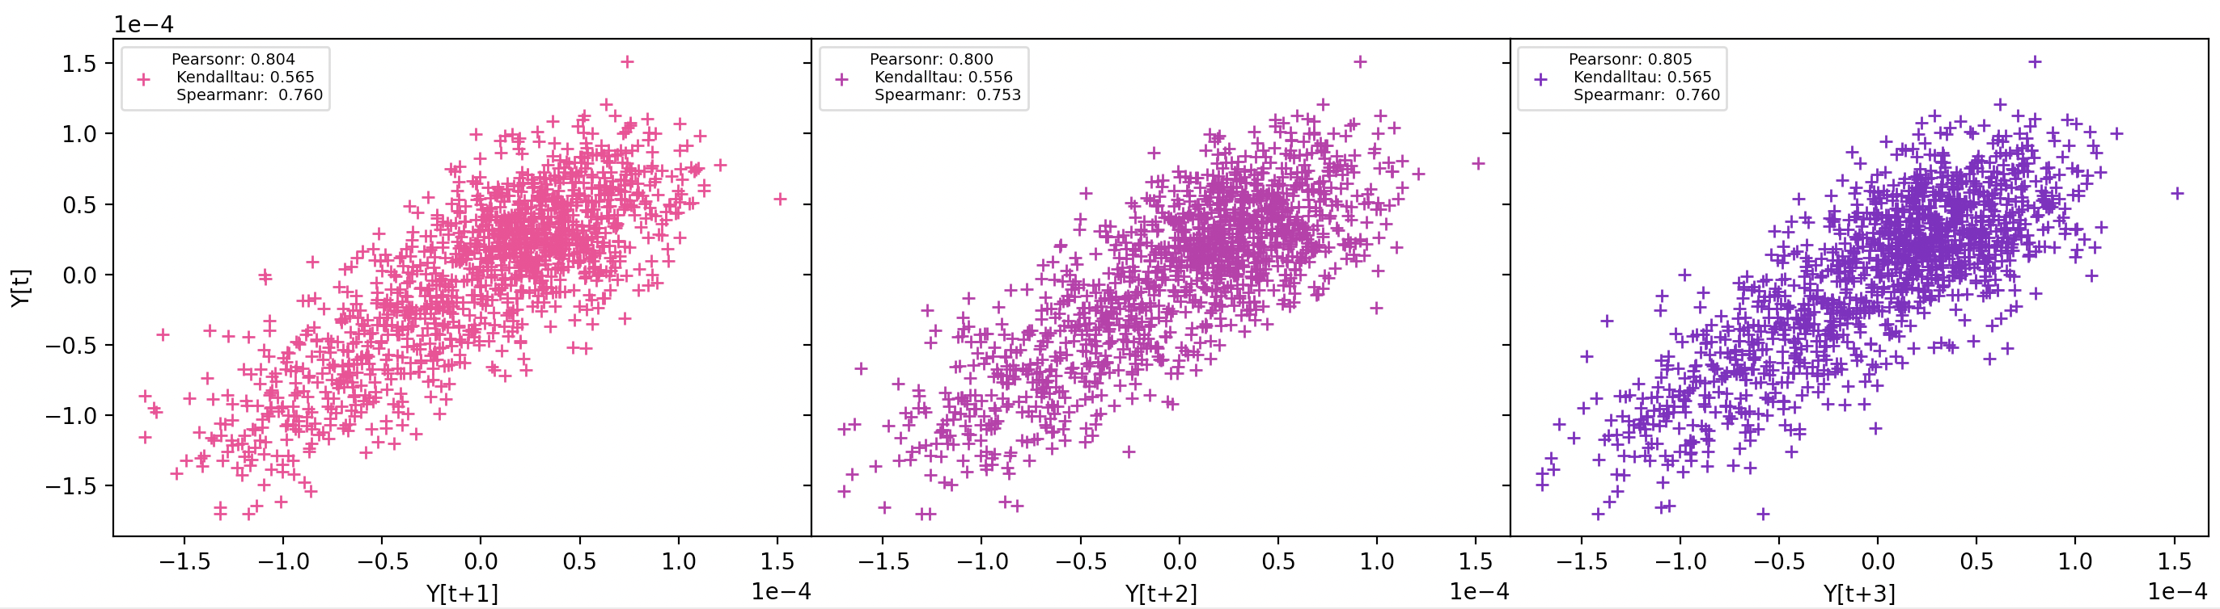
Feature selection
OUT OF LOOP -----------> No feedback stabilization
IN LOOP -----------> Feedback stabilization

Slide 8
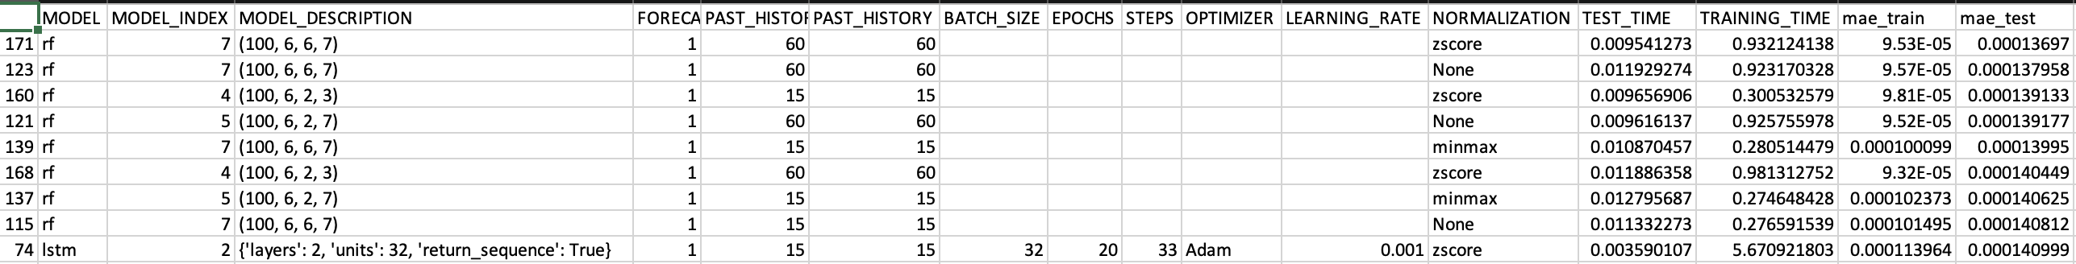
Best ML approach
General parameters:
ML Approaches:
MLP [32, 16, 8]
LSTM
layers: 1 and 2
CNN [16, 3, 2]
RF
max_depth: 2 and 6;
min_samples_split: 2 and 6;
min_samples_leaf: 3 and 7.
LR
Compared:
3 Normalization methods: "None", "minmax", and "zscore”;
3 Past history: 15, 60, and 120;
2 Learning ate: 0.001 and 0.01.
Constant:
batch_size: 32;
epochs: 20;
max_steps_per_epoch: 10000.
Metrics = | Real(CentroidError) - Predicted(CentroidError) |

Slide 9
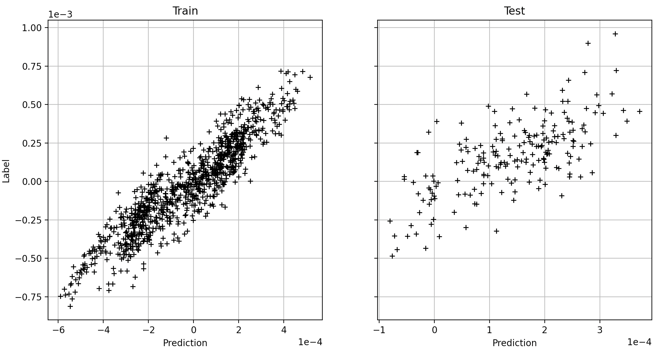
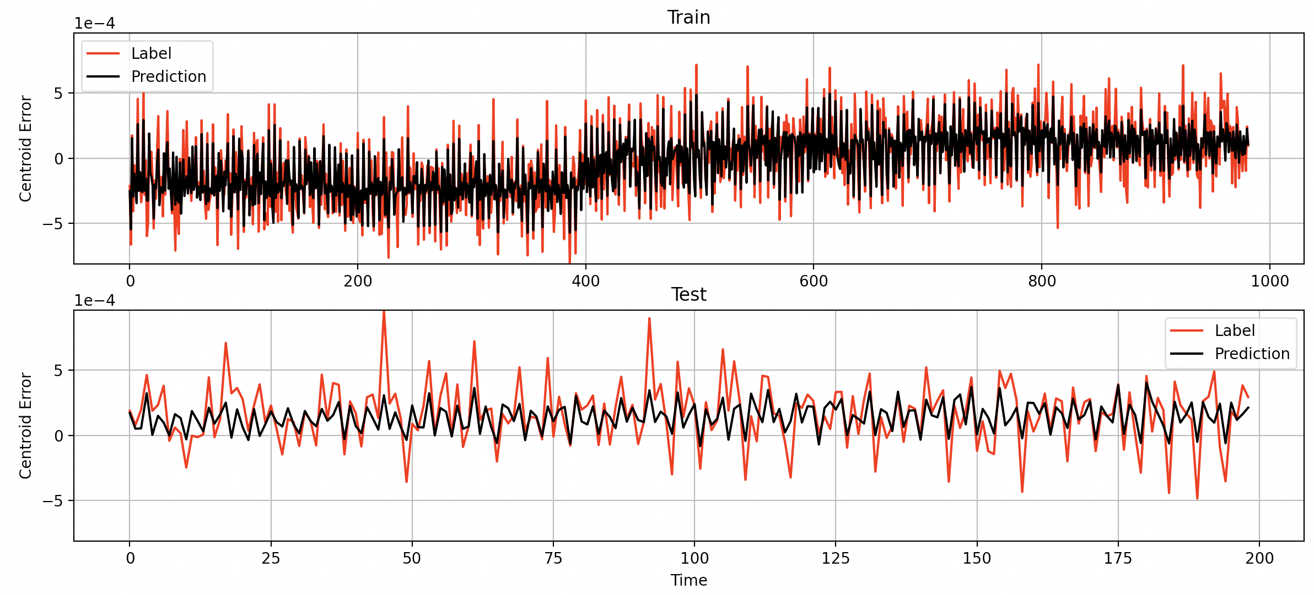
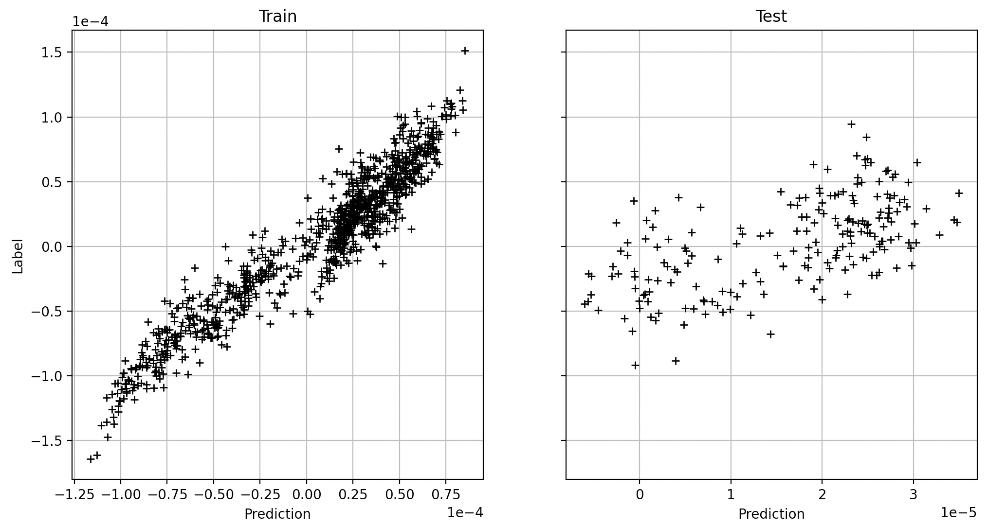
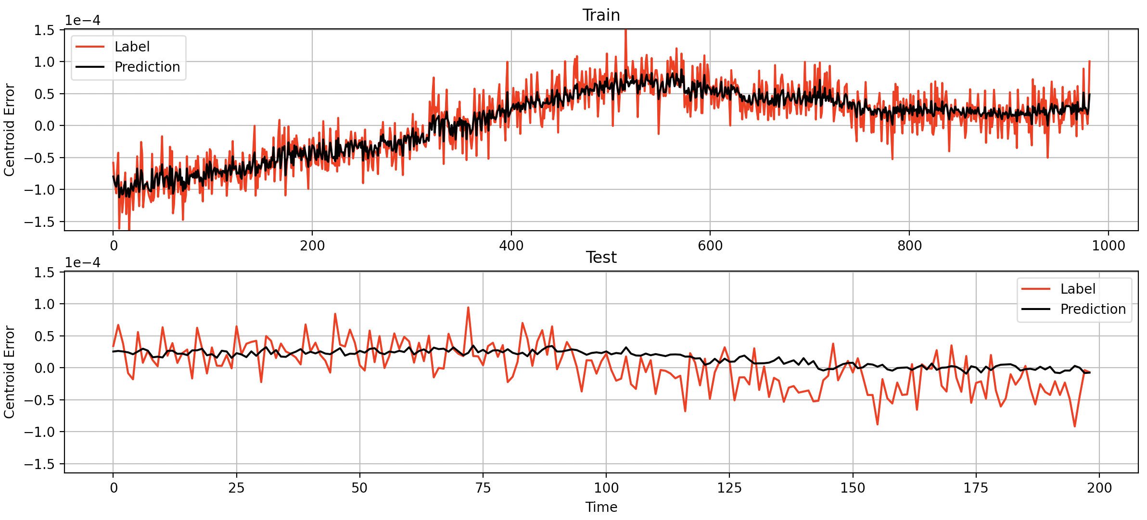
Results
OUT OF LOOP -----------> No feedback stabilization
IN LOOP -----------> Feedback stabilization

Slide 10


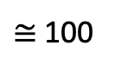
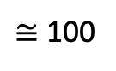
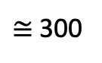
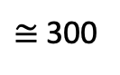
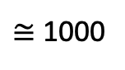
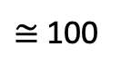
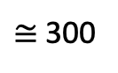
Conclusion
Not much difference in terms of results using the time shift or not
Not much difference using only the parameters with highest correlations (RF Phs, RF AMP, Laser Amp, PhaseDifference)
When working in close loop the correlations tend to zero (probably the reason of the really bad performance). However some interesting information can be obtained from the previous centroid.
Next Steps
We have to decide/identify a way to assess the centroid better
Decide if apply or not the time shift
Try Cross validation:
Training
Test
Currently:
$≅$ 1000
$≅$ 300
Training
Test
Training
Test
Training
Test
- Cross validation the dataset:
$≅$ 300
$≅$ 100
$≅$ 300
$≅$ 100
$≅$ 300
$≅$ 100

